Slide 1
Netzwerk Academy
Machine Learning
By
Navya Raj

Slide 2
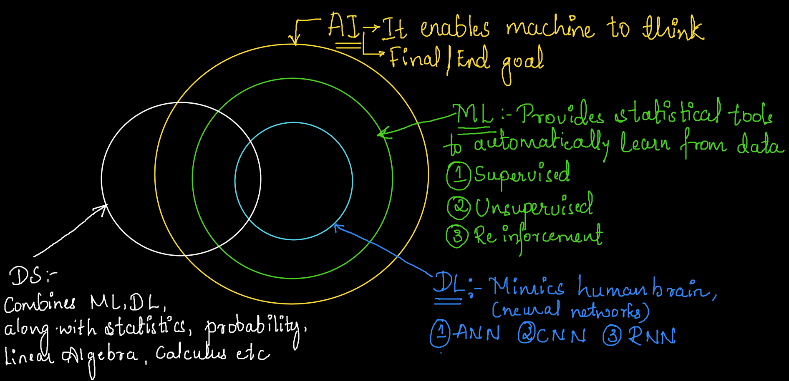
AI v/s ML v/s DL v/s Data Science

Slide 3
Machine Learning Definition:
It is an art and science of programming computers so they Can Learn From Data.
OR
A Computer program is said to learn Experience ‘E’ w.r.t some Task ‘T’ & Some performance Measure ‘P’, If Its Performance on ‘T’, as Measured by ‘p’, Improves with experience ‘E’.

Slide 4



EXAMPLES:

Slide 5



Continue…

Slide 6
Types Of Data:
Structured data
Semi-structured data
Unstructured data

Slide 7
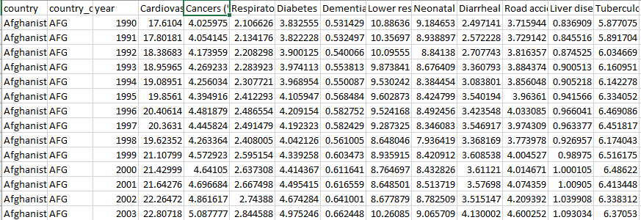
Structured Data
Structured data is highly-organized and formatted in a way so it's easily searchable in relational databases

Slide 8

Unstructured Data
Unstructured data has no pre-defined format or organization, making it much more difficult to collect, process and analyse.
Ex: Texts, Audios, Videos, Comments, Tweets, etc.

Slide 9
Semi-structured Data
Semi-structured data is a form of structured data that does not conform with the formal structure of data models associated with relational databases or other forms of data tables, but nonetheless contain tags or other markers to separate semantic elements and enforce hierarchies of records and fields within the data.
Ex : JSON data, XML data, etc.

Slide 10
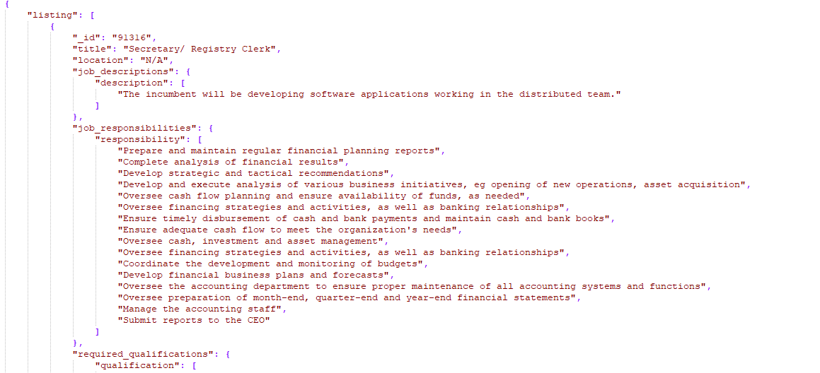

Slide 11
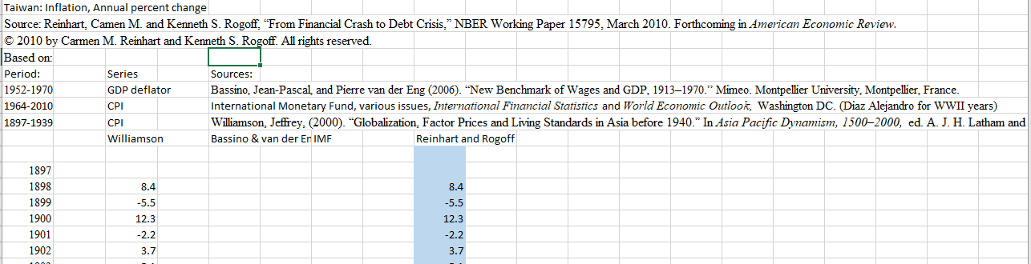
Raw Data
Data in its original form which is extracted from a particular source.

Slide 12
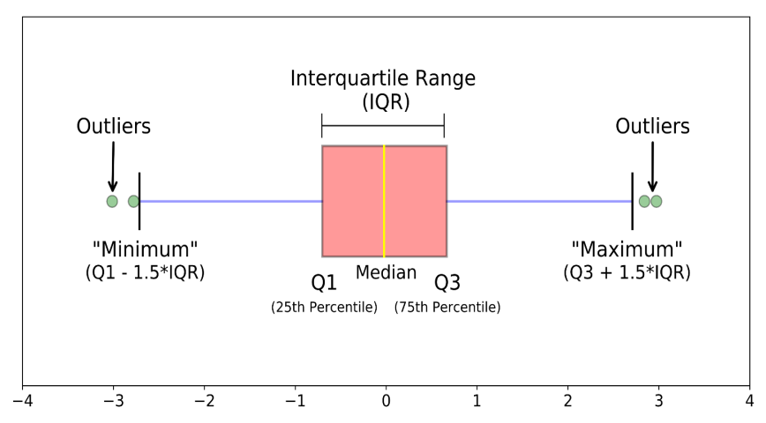
Why do we pre-process data?
Remove existing outliers
Fix the missing values if possible
Fix the errors(format, numeric, etc.)
Remove irrelevant/non-useful data
Keep only useful data

Slide 13
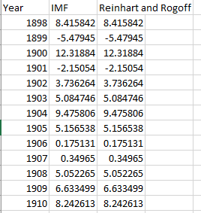
Processed data

Slide 14

Raw Unstructured Data

Slide 15
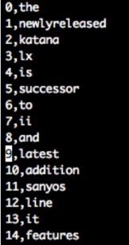
Processed data

Slide 16
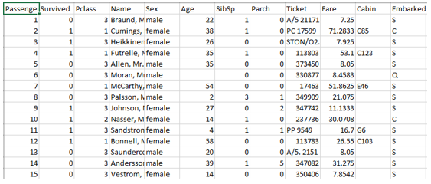
Variables in a Data / Dataset
1. Predictors / Independent variables
Input variables which influence the output
2. Response / Dependent variables
Output variable whose value varies based on input

Slide 17
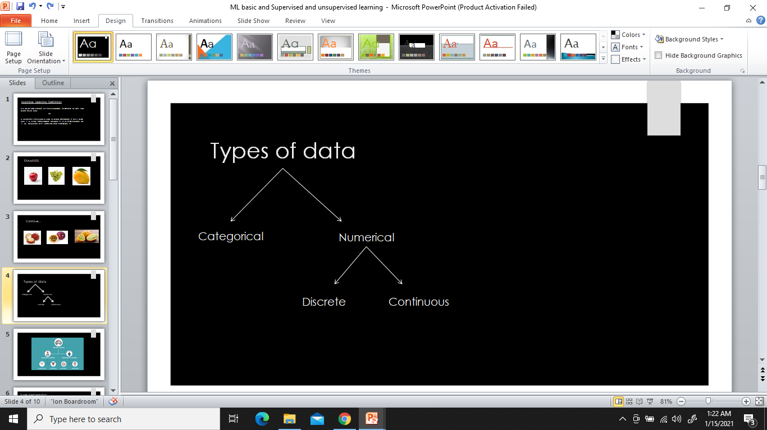

Slide 18
Types of Variables
Quantitative variables:
Variables which describe measurable quantity as number, like ‘how many’ or ‘how much
Continuous :- observations can take any value between the specified range.
Ex : Marks of students, Salary for a fresher
Discrete :- Observations can take distinct value.
Ex: No. of children's, No. of bikes
Qualitative variables:
Values which define the characteristics of data unit. There are 2 types:
Ordinal – Observations which can take values which can be logically ordered.
Ex:- Academic grades (A, B, C), Movie star ratings ( 1 is poor, 5 is excellent)
Nominal or categorical – Observations which take values which cannot be ordered or sequenced. Example :- Gender, Eye colour, religion, etc.

